Slide 1
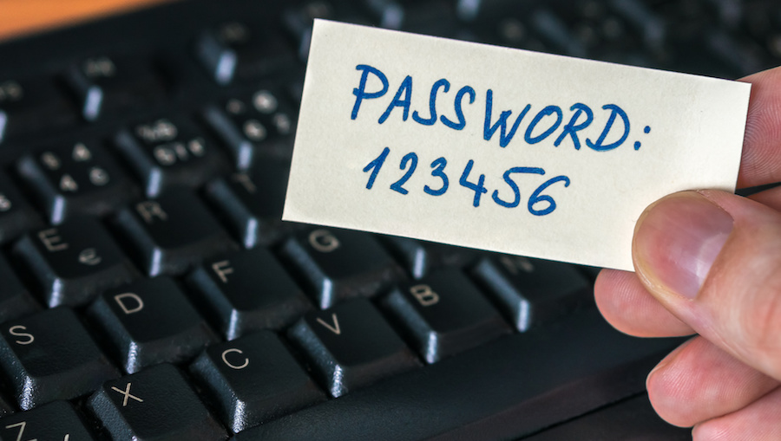
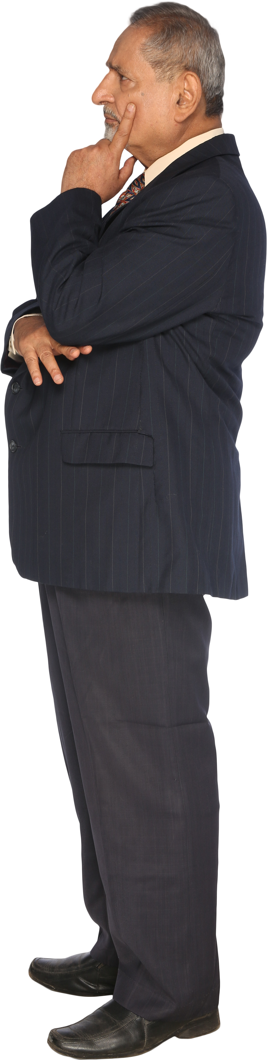
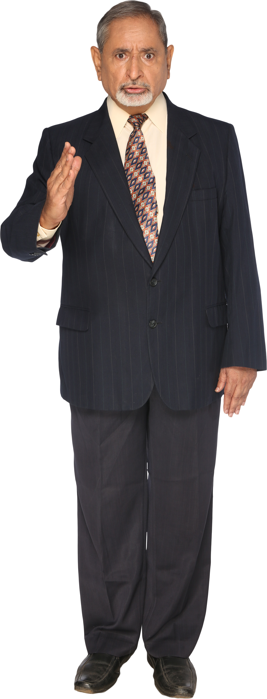
Password security
And why you are unable to remember password just for once???
Sponsored by NordVPN

Slide 2

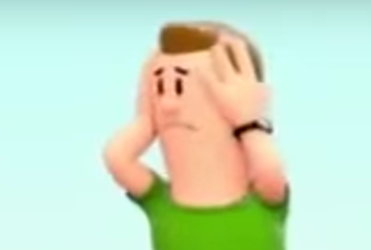


Content (Content)
Creating a secure password
Secure your secure Password
Not get your passwords stolen using nordvpn
If you forgor💀 your password
Password manager

Slide 3
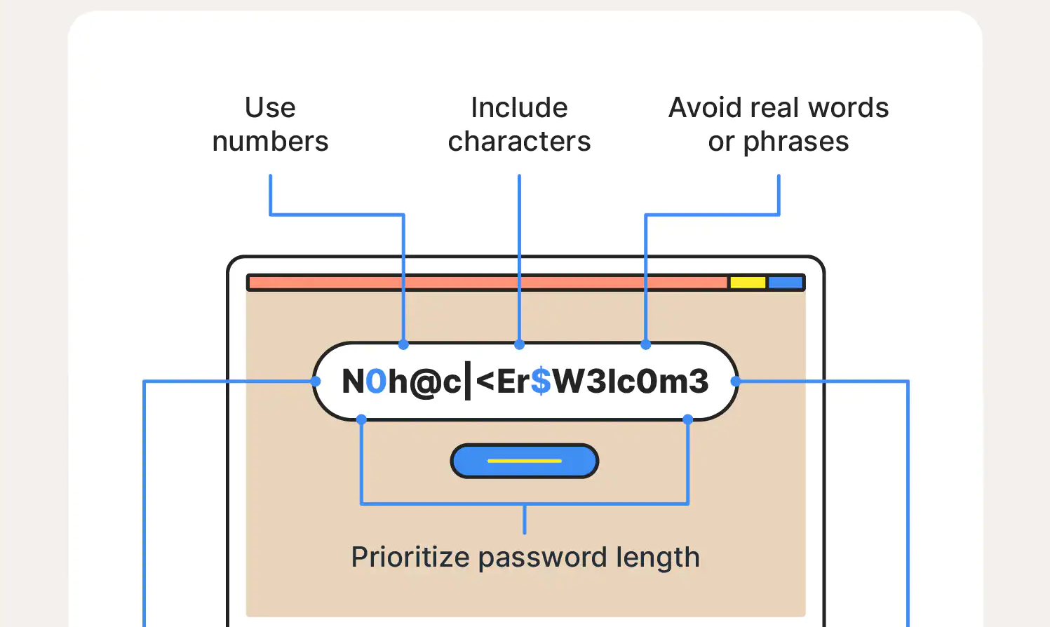

Creating a secure password
an example:
Have a looooooooooooooong password.
Use numbers and special characters.
Use uppercase and lower-case letters.
Avoid words and leet speek.
Don't reuse a password.
You can also use random string generators or similar.
If you followed these rules, you should not be able to remember them all

Slide 4
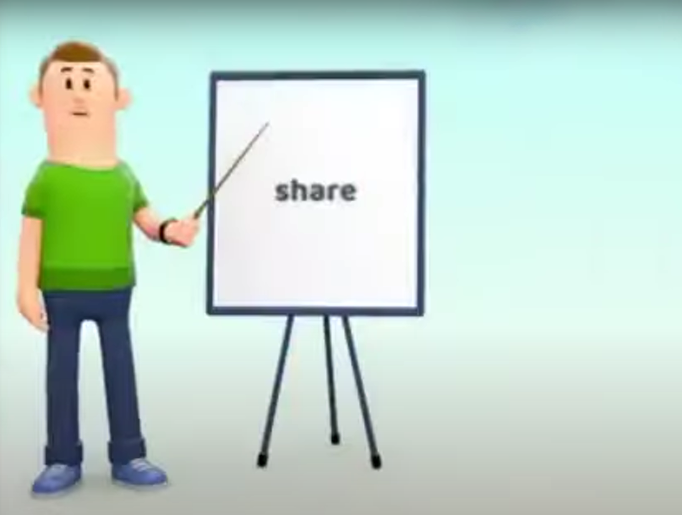


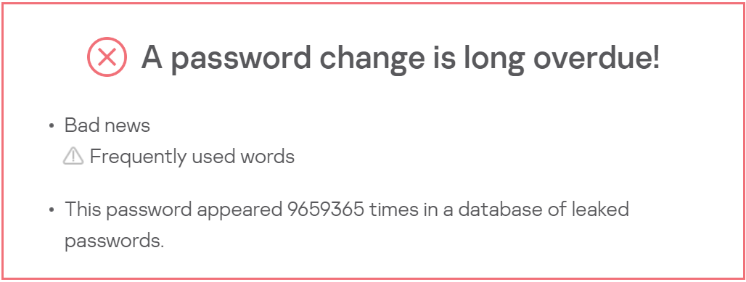

Insecure Passwords (do not use)
If a Monke™ tries to visit your account, they'd probably first check one of these passwords:
123456
password
12345678
P@ssw0rd
qwerty
654321
111111
123123
Password1!

Slide 5

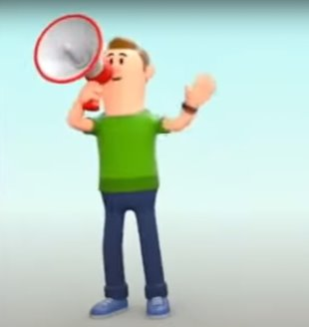
Not get your password stolen using NordVPN

Slide 6



Secure Your secure password
Use two-factor authentication
Physical Key
Bring them to paper (outdated)
Use another device for authentication
Don’t give it to people asking for it, even if they want to give you free Robux
Don’t change your password frequently, it is unnecessary unless there was a breach

Slide 7
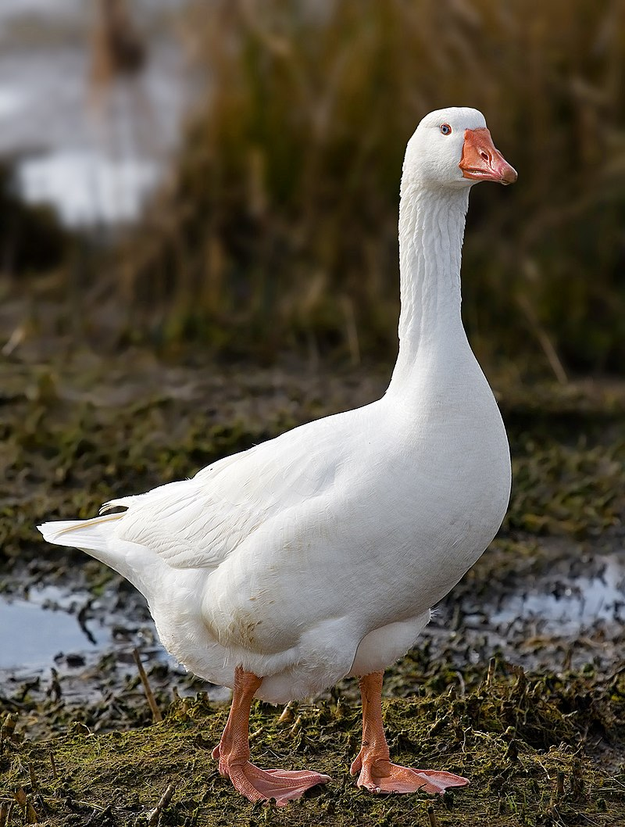

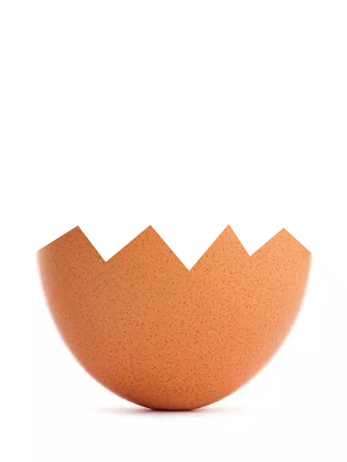




What if you foRgor💀 your PaSSworD (DONT)
Don’t forgor your password
Reset it or regret it
Create a new account every time you forgor (not useful)
Many sites offer you to enter a password-reset-mail or security questions
Contact support
Store related documents and similar as they can help support to recover your accounts
Fish

Slide 8

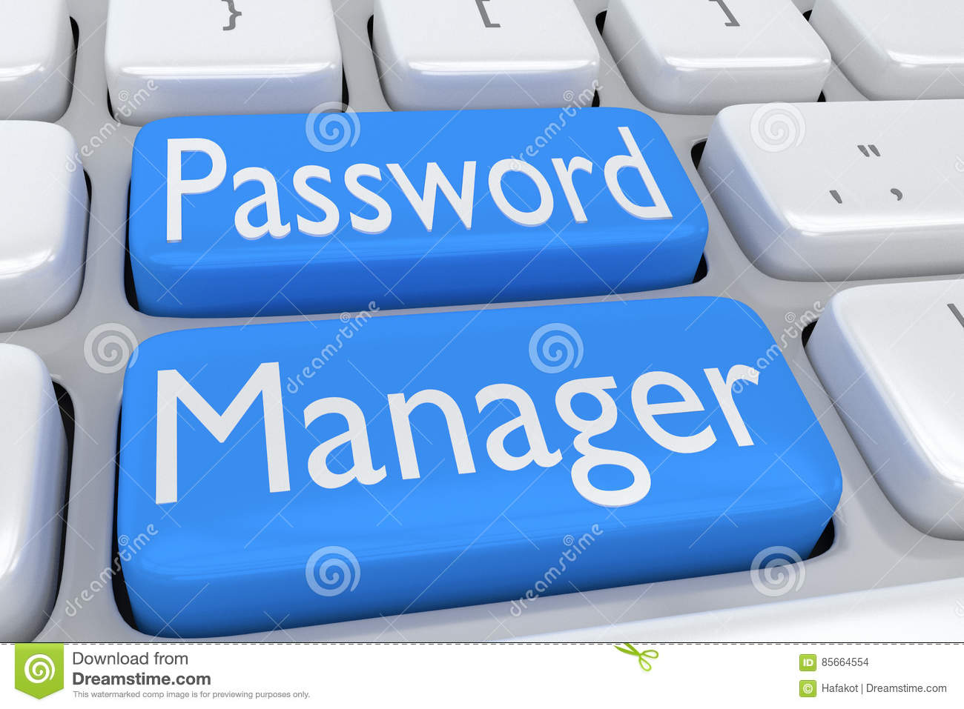


Password-Managers (do not use lastpass)
Password manager manages passwords (generate, store)
Use an offline password manager (like KeePassXC)
DO NOT use cloud-based password managers or the one in your browser
Cloud based managers are big security risks (unless)
Do not use Masterlock to lock the furniture containing your written down password from 56 years ago
Visualization of password storage ➡️
after corruption

Slide 9
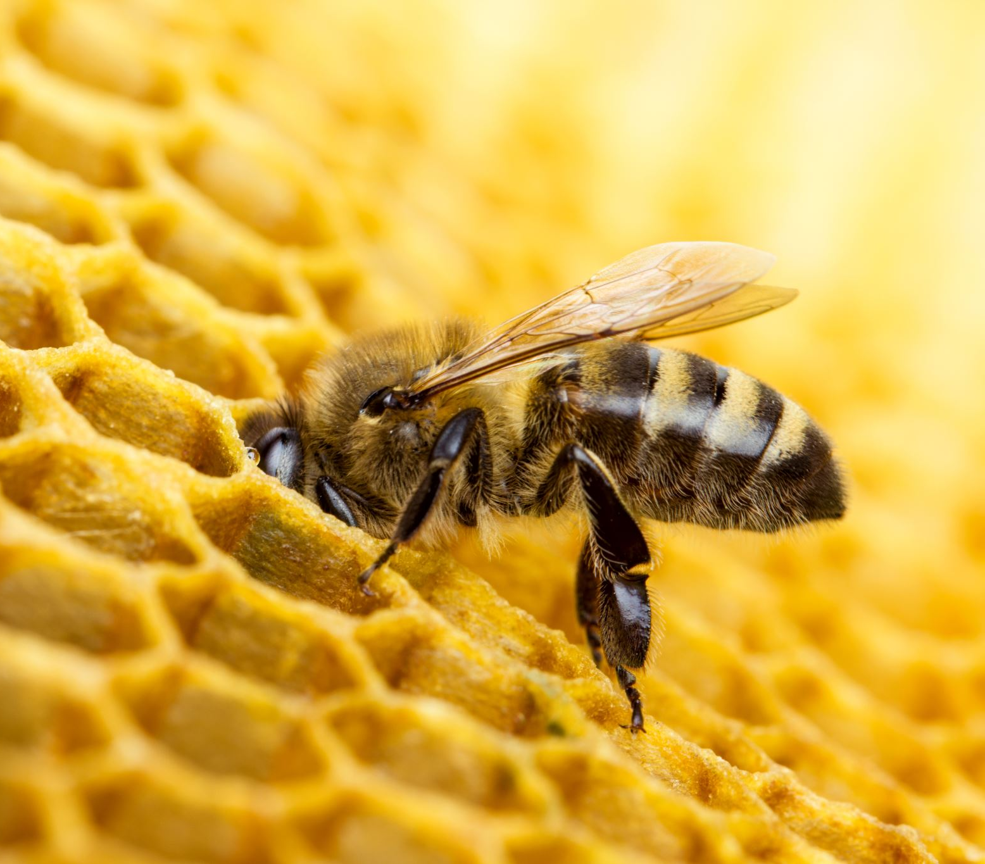

Source(s)
Get Honey
PowerPoint Stock Images
Windows Security Help™
Common sense
WE HO'E U LIKE

